Slide 1
Market Basket Analysis
FOR GROCERIES DATASET
PRESENTER
COURSE
MUKTABAI DAVARGE
GAYATRI GADGUL
ADVANCED CERTIFICATION PROGRAM IN DATA ANALYTICS
DATE
2023 JUNE 28TH

Slide 2
2
Table of Contents
3
4
5
6-10
INTRODUCTION
PROBLEM STATEMENT
ABOUT MARKET BASKET ANALYSIS
DATA PREPROCESSING
11-13
14-18
19
EXPLORATORY DATA ANALYSIS
METHODOLOGY
SUMMARY

Slide 3
3
Introduction
EXPLORE
One of the key problems in every company, including small and medium enterprises, is how to determine the inventory level for each product that will be sold to their customers appropriately as it can suppress the build up of inventory as well as avoid the stock out.
The fundamentals of market basket analysis for small businesses
GOALS
The study is aimed to understand the behavior of consumers in purchasing the products so it can be used to predict the purchasing for the next period.

Slide 4
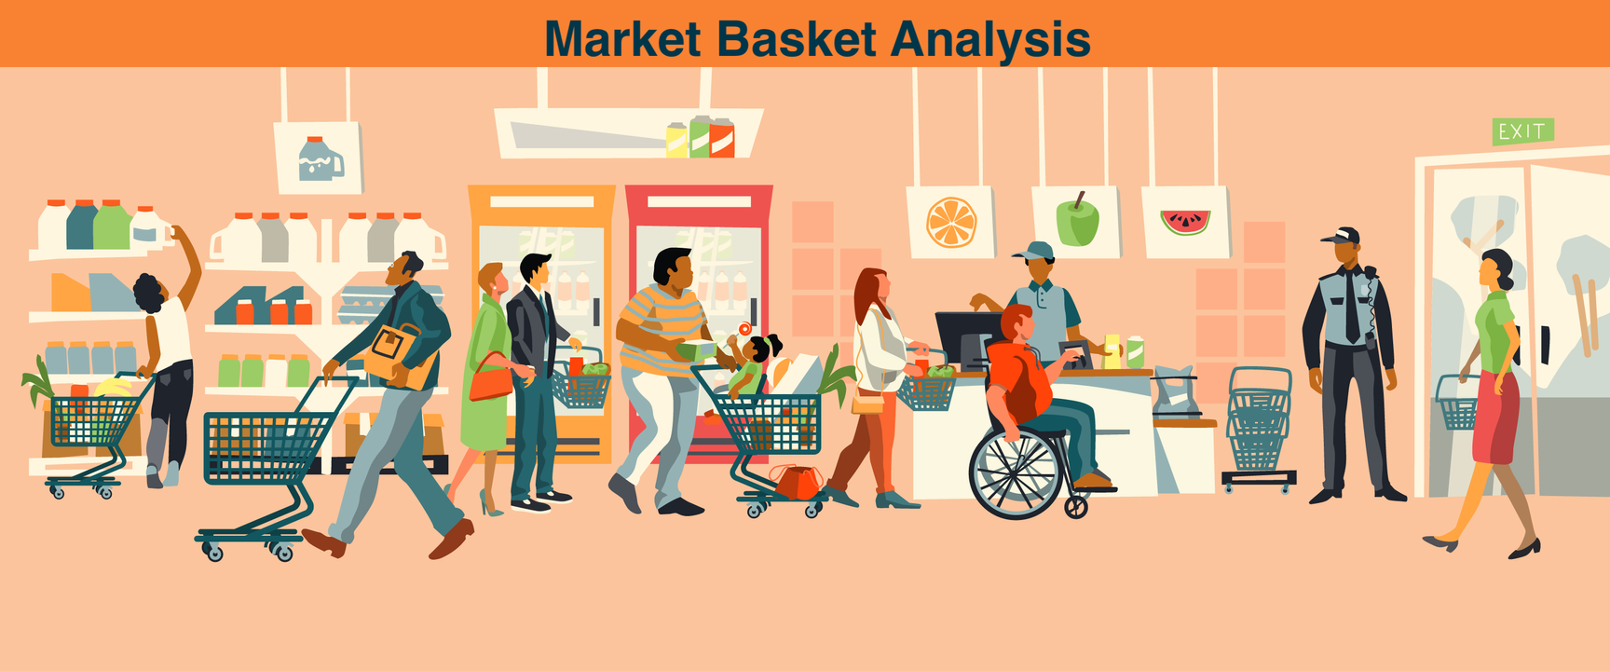
4
Problem Statement
Identifying a customer's shopping basket pattern which significantly helps to use that information in respect of business strategy needs, one of which is placing the most frequently-purchased products simultaneously into one specific area.

Slide 5
5
What is Market Basket Analysis?
Market Basket Analysis is one of the key techniques used by large retailers to uncover associations between items. It works by looking for combinations of items that occur together frequently in transactions. To put it another way, it allows retailers to identify relationships between the items that people buy.
Market Basket Analysis, Why?
May help to develop more effective product placement, pricing, cross-sell, and up-sell tactics.
Improves user experience and encourages purchases, which adds direct business value.
An opportunity to be promoted can be obtained.

Slide 6
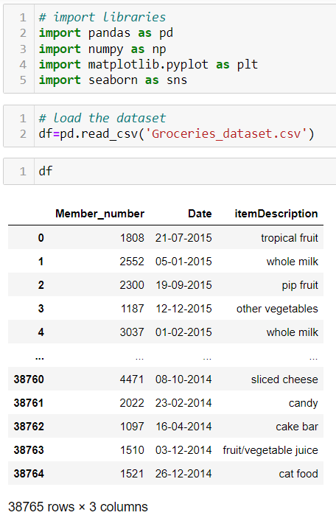
6
Data Preprocessing
A step in the data mining and data analysis process that takes raw data and transforms it into a format that can be understood and analyzed by computers and machine learning.

Slide 7
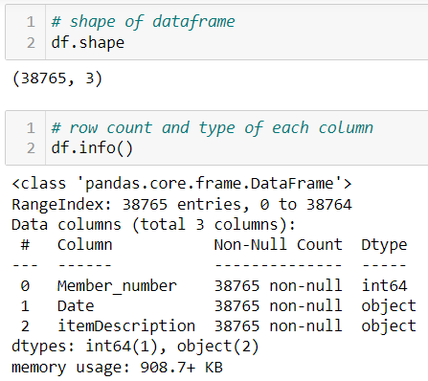
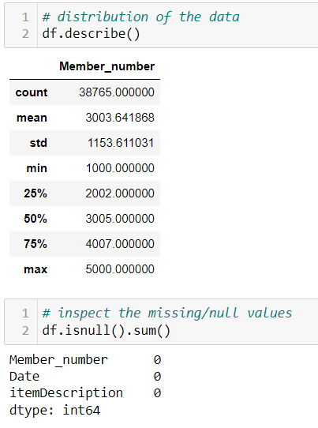
7

Slide 8
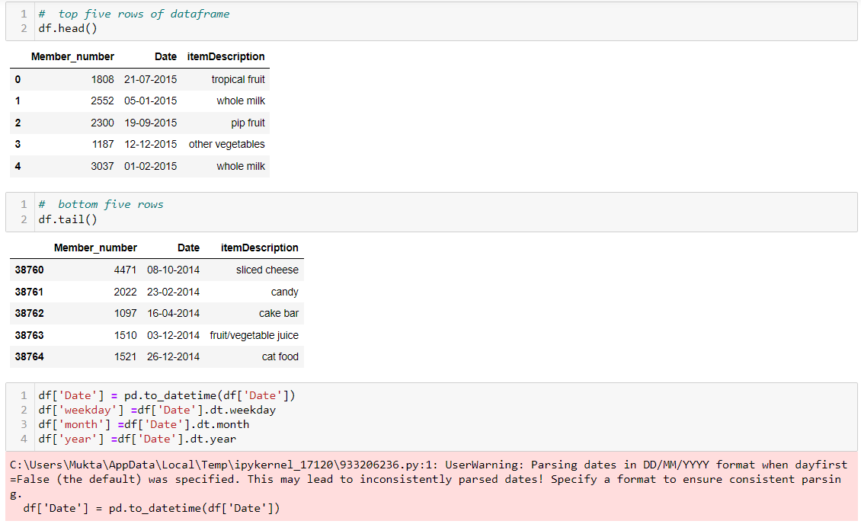
8

Slide 9
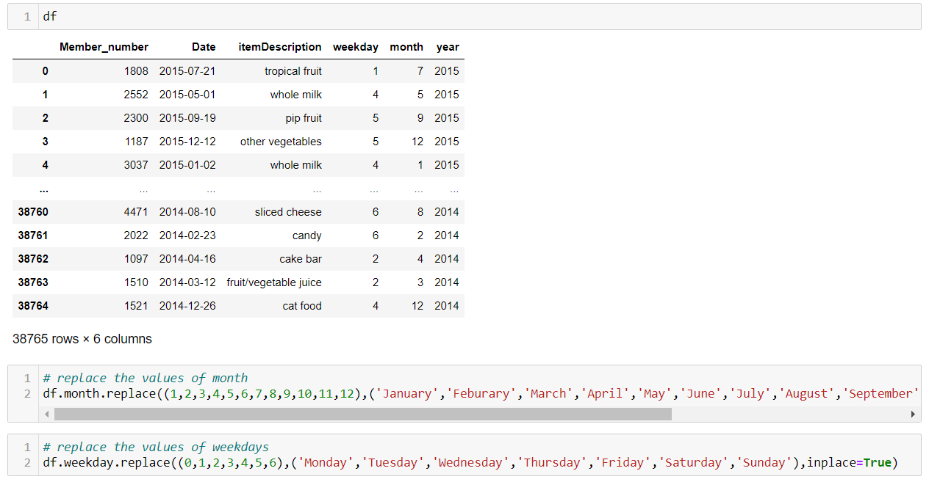
9

Slide 10
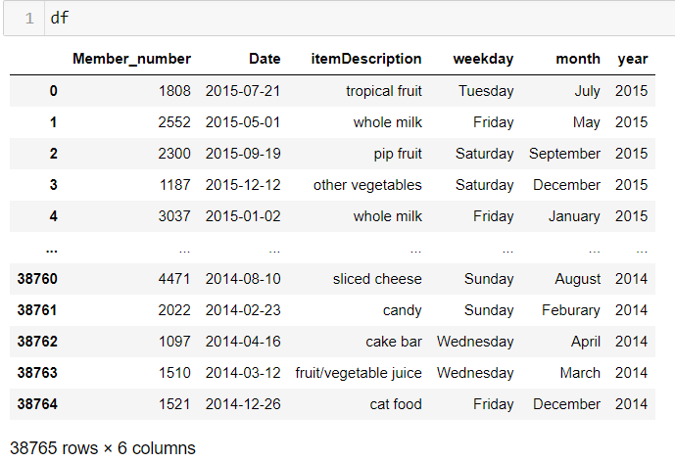
10

Slide 11
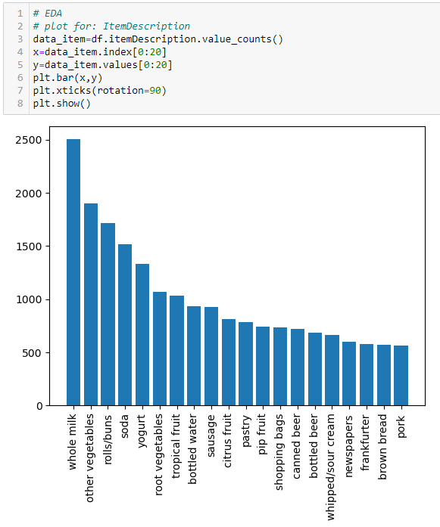
11
Exploratory Data Analysis
Exploratory data analysis is an approach of analyzing data sets to summarize their main characteristics
is an approach that is used to analyze the data and discover trends, patterns, or check assumptions in data with the help of statistical summaries and graphical representations.

Slide 12
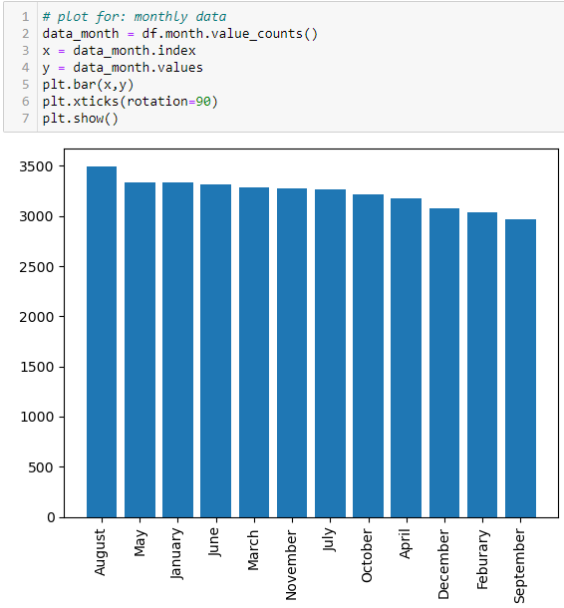
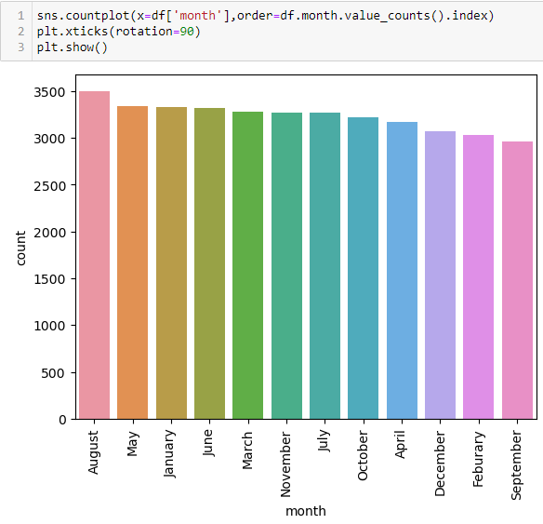
Countplot
12
Used to display the count of categorical observations in each bin in the dataset. A count plot resembles a histogram over a categorical variable as opposed to a quantitative one.

Slide 13
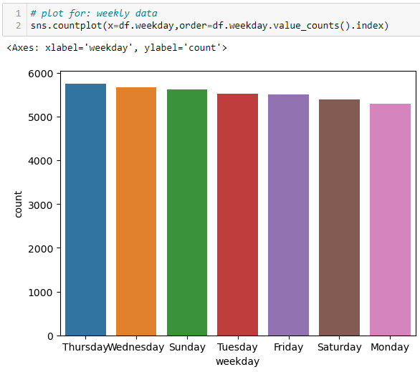
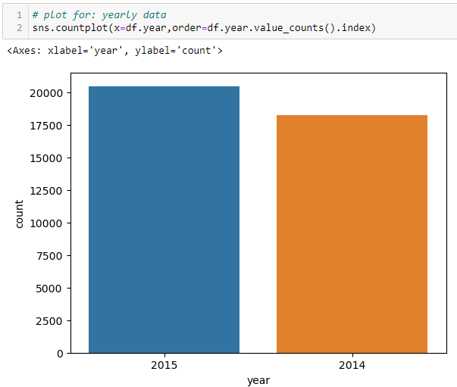
13

Slide 14

Methodology
14
Here we have used Association rule learning is a type of unsupervised learning technique
Association rule - a type of unsupervised learning technique, that checks for the dependency of one data item on another data item and maps accordingly so that it can be more profitable.
Used to display the count of categorical observations in each bin in the dataset.

Slide 15
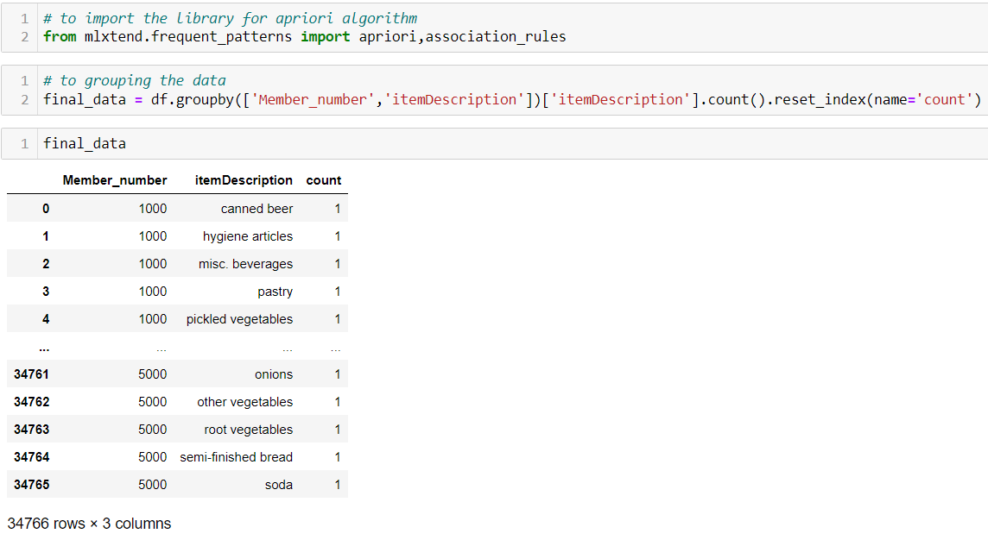
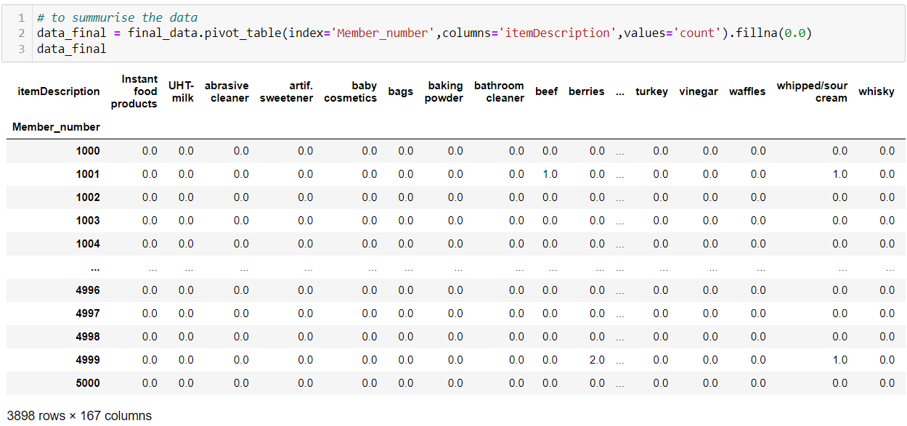
15

Slide 16
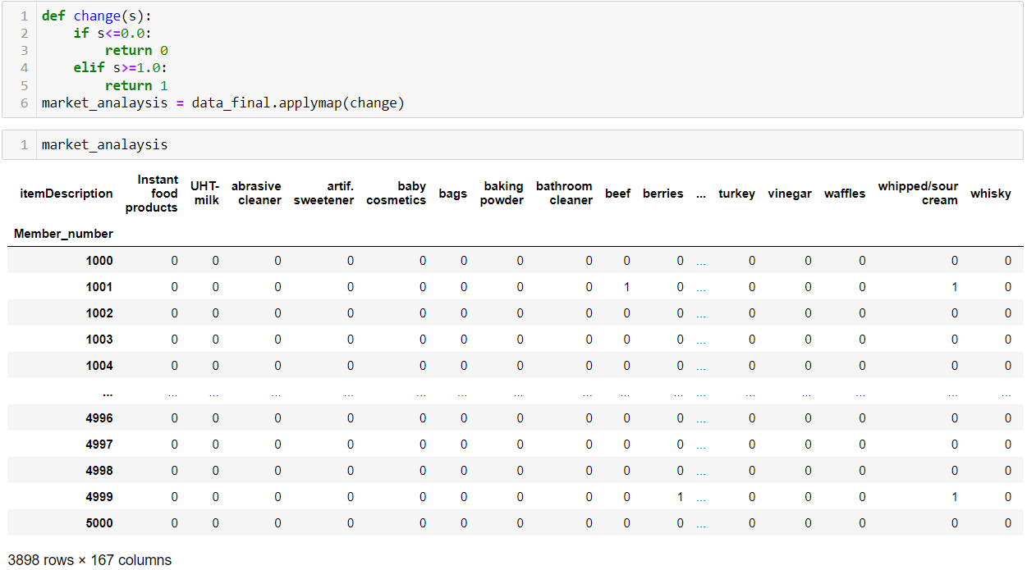
16

Slide 17
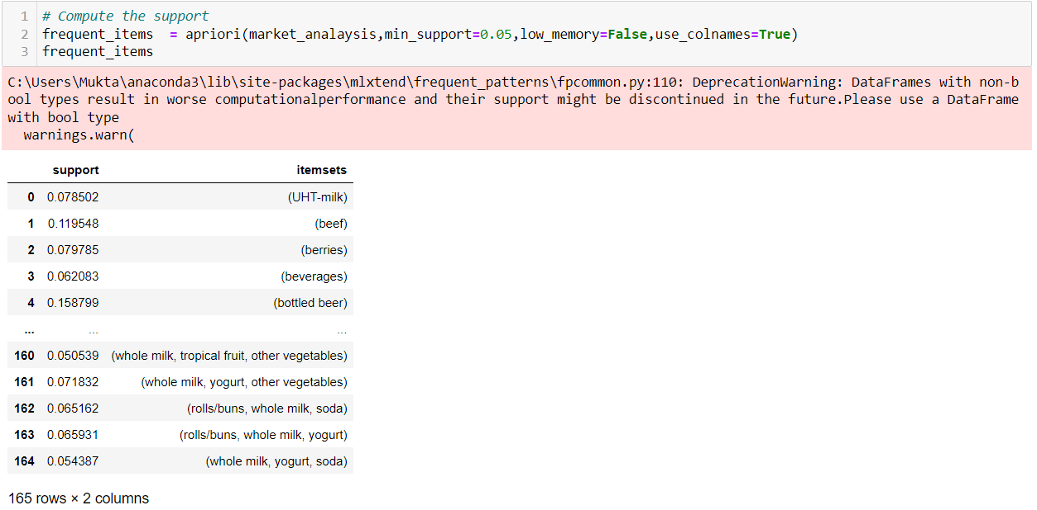
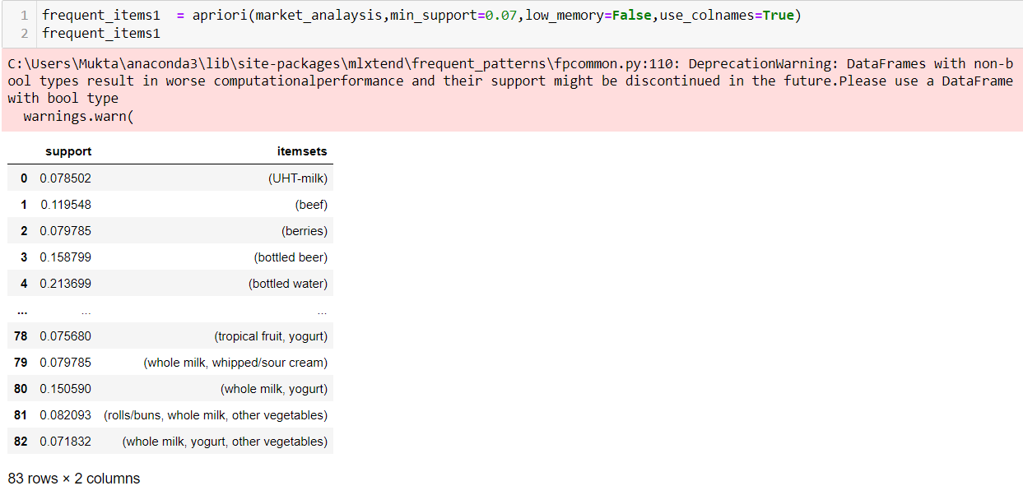
17

Slide 18
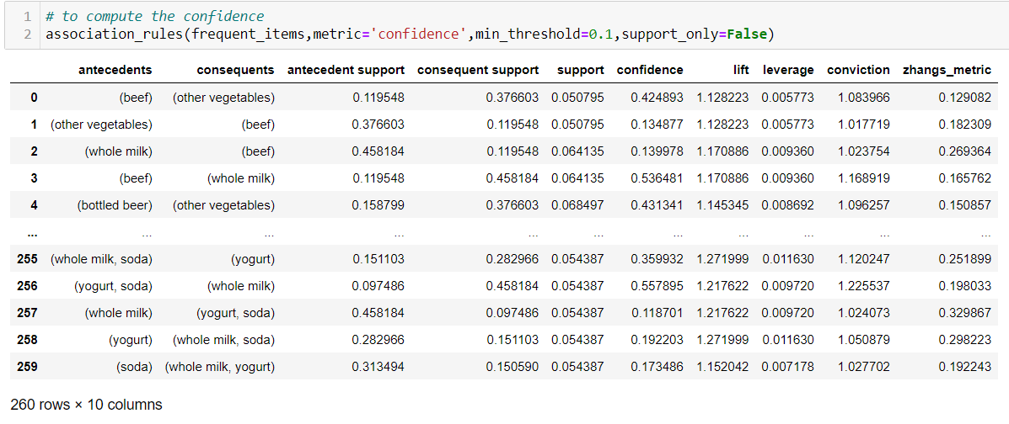
18

Slide 19
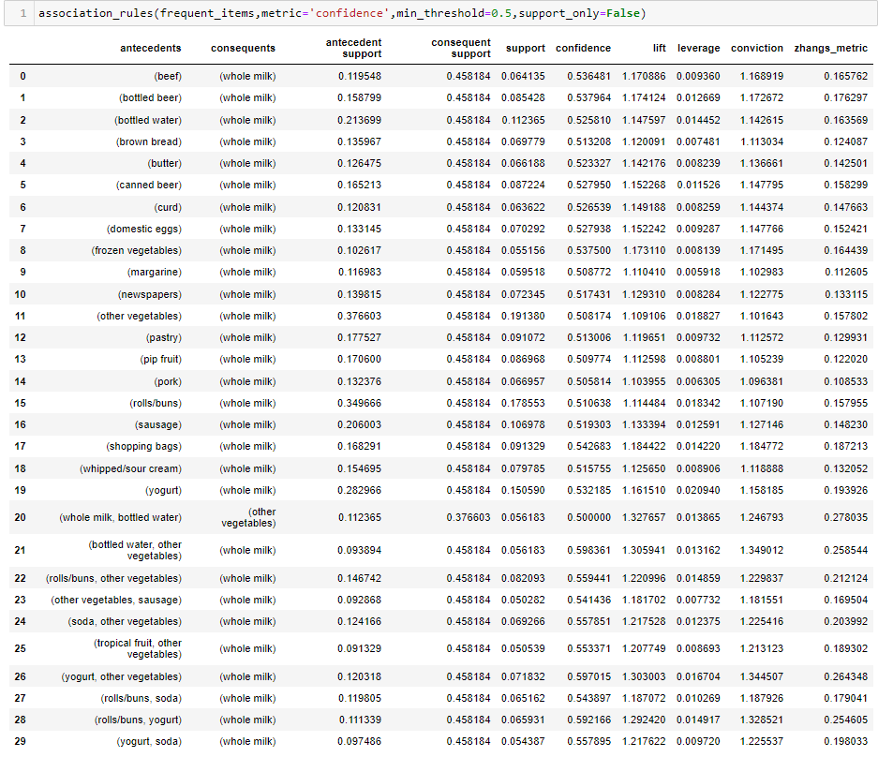
Summary
19
The tool used for association rule mining is apriori algorithm
the rules generated by MBA are association rules that have form "If antecedent (A), then consequent (B)". Each rule is equipped with a support level that indicates the number of transactions containing A and B and confidence level that is a measure of accuracy which is the rule of association rules.

Slide 20
Thank You

